Slide 1

Customer Shopping Behavior Analysis
Analyzing 3,900 purchases to uncover insights into spending patterns, customer segments, and product preferences that drive strategic business decisions.

Slide 2
Dataset Overview
3,900
18
50
25
Total Purchases
Data Columns
Locations
Products
Transactions analyzed across all categories
Features covering demographics and behavior
Geographic diversity in customer base
Items tracked across four categories
Key features include customer demographics (age, gender, location, subscription status), purchase details (item, category, amount, season, size, color), and shopping behavior (discounts, promo codes, previous purchases, frequency, review ratings, shipping type).

Slide 3

Data Preparation & Cleaning
01
Data Loading
Imported dataset using pandas for analysis
02
Initial Exploration
Used df.info() and .describe() for structure review
03
Missing Data Handling
Imputed 37 missing Review Ratings with median by category
04
Column Standardization
Renamed columns to snake_case for consistency
Feature engineering created age_group and purchase_frequency_days columns. Verified discount_applied and promo_code_used redundancy, dropping the latter.

Slide 4

Revenue Analysis by Gender
Male Customers
$157,890 total revenue
Representing 68% of total sales
Female Customers
$75,191 total revenue
Representing 32% of total sales
Male customers generate more than double the revenue of female customers, suggesting opportunities for targeted marketing campaigns to balance gender engagement.

Slide 5

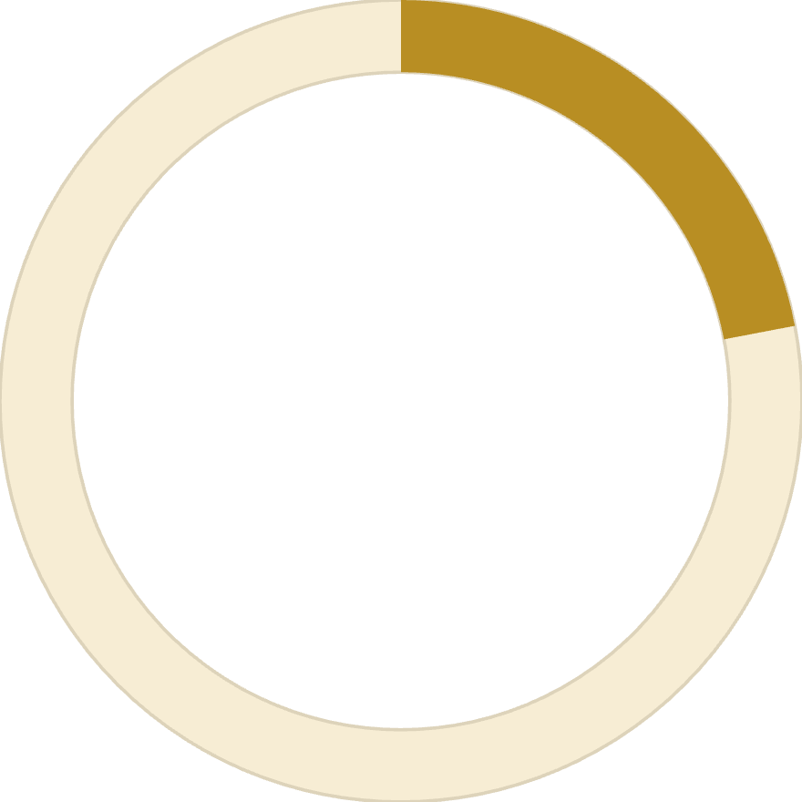

High-Value Discount Users
839
22%
$60
Smart Shoppers
Customer Share
Average Spend
Customers using discounts while spending above average
Percentage of total customer base
Purchase amount threshold identified
These customers demonstrate that discounts don't necessarily reduce purchase value—they attract quality-conscious buyers who maintain high spending levels.

Slide 6
Top-Rated Products
1
2
3
Gloves
Sandals
Boots
Average rating: 3.86
Average rating: 3.84
Average rating: 3.82
4
5
Hat
Skirt
Average rating: 3.80
Average rating: 3.78
These top-rated products should be prominently featured in marketing campaigns and product positioning strategies to capitalize on customer satisfaction.

Slide 7
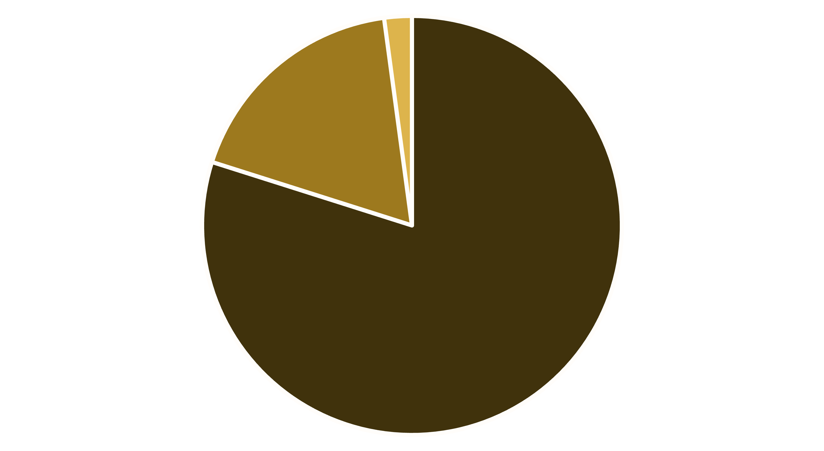
Customer Segmentation Insights
Loyal
Returning
New
Loyal Customers Dominate
New Customer Opportunity
80% of customers are classified as loyal, indicating strong retention. Focus on moving returning customers (18%) into the loyal segment through targeted loyalty programs.
Only 2% are new customers, suggesting potential for acquisition campaigns to expand the customer base and drive growth.

Slide 8

Subscription vs. Non-Subscription Performance
Subscribers
1,053 customers
Average spend: $59.49
Total revenue: $62,645
Non-Subscribers
2,847 customers
Average spend: $59.87
Total revenue: $170,436
Despite similar average spending, non-subscribers generate significantly more total revenue due to volume. Among repeat buyers (>5 purchases), 958 are subscribers while 2,518 are not—a major opportunity to convert high-frequency buyers.

Slide 9
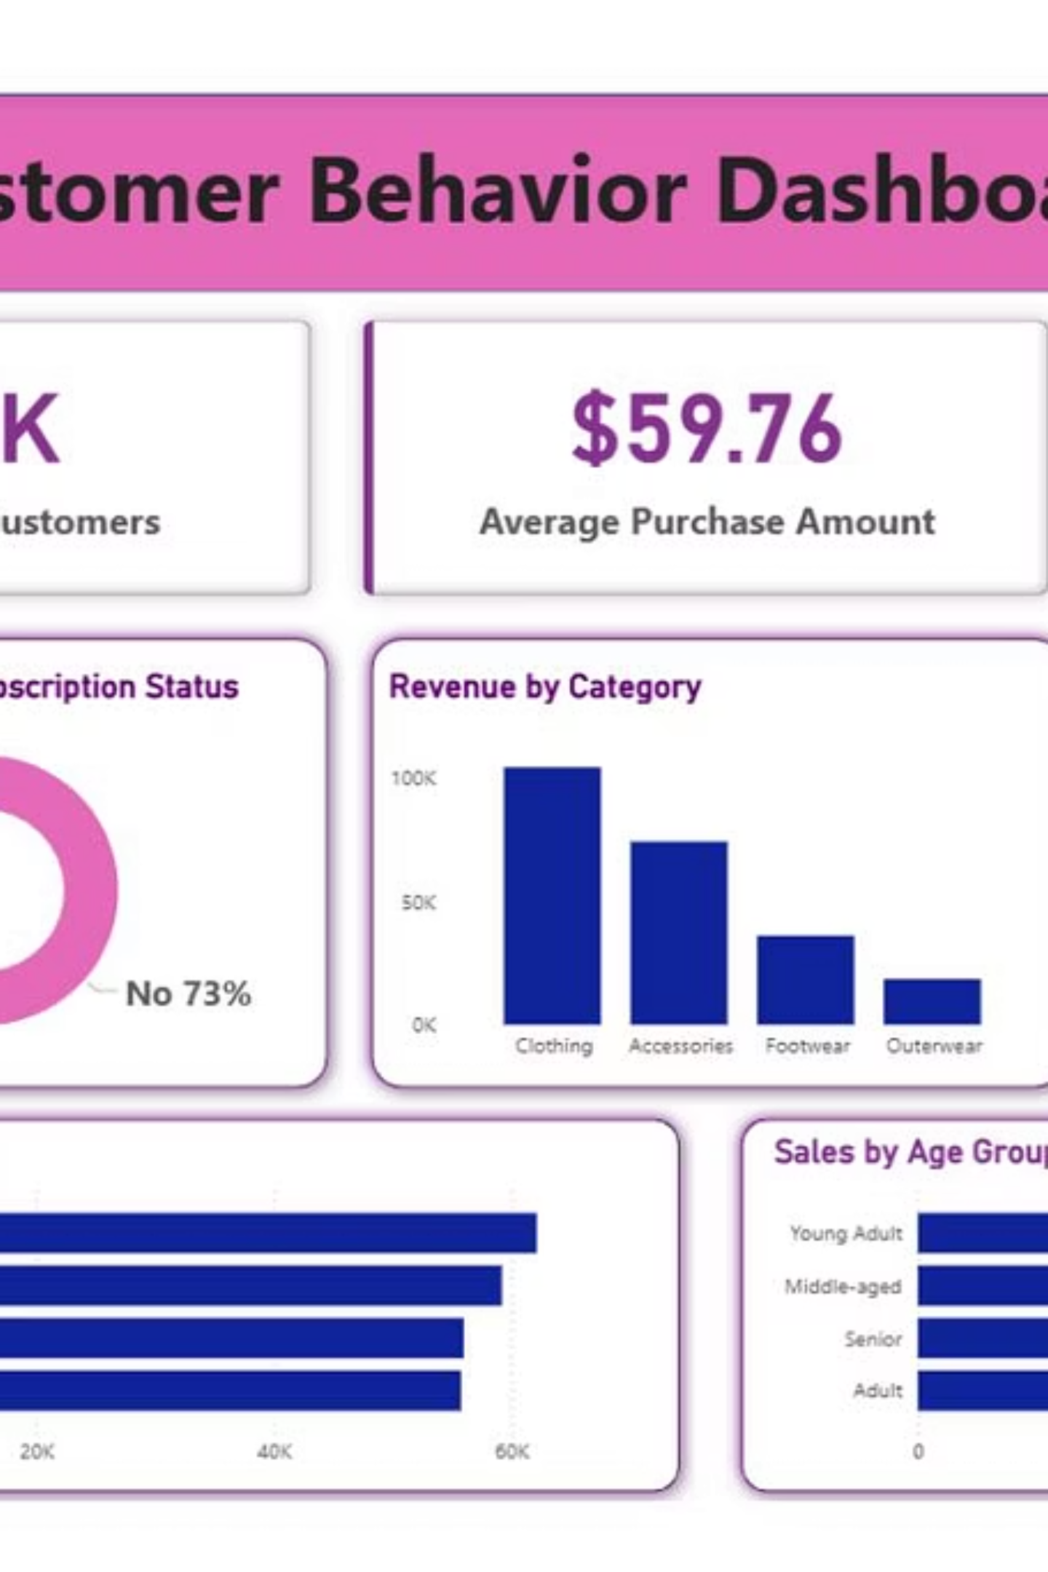
Power BI Dashboard
Interactive dashboard visualizes key metrics including revenue by age group, shipping preferences, product performance, and customer segmentation for real-time business intelligence.

Slide 10

Strategic Recommendations
Boost Subscriptions
Loyalty Programs
Review Discount Policy
Promote exclusive benefits to convert high-frequency buyers into subscribers
Reward repeat buyers to accelerate their journey into the loyal segment
Balance promotional sales boosts with margin control and profitability
Product Positioning
Targeted Marketing
Highlight top-rated and best-selling products in marketing campaigns
Focus efforts on high-revenue age groups and express-shipping users

